Slide 1
E-COMMERCE

Slide 2
WHAT IS COMMERCE?
Commerce is a division of trade or production which deals with the exchange of goods and services from producer to final consumer

Slide 3
WHAT IS E-COMMERCE?
Electronic commerce commonly known as e-commerce or eCommerce
Electronic commerce is the paperless exchange of business information using electronic data interchange (EDI) and electronic funds transfers (EFT).
E-Commerce is a process of buying, selling, transferring, or exchanging products, services, and/or information via electronic networks and computers (WEB)
The concept of e-commerce is all about using the Internet to do business better and faster.
Notes:
1. What is EDI?
A: Electronic Data Interchange (EDI) is the structured transmission of data between organizations by electronic means. It is used to transfer electronic documents or business data from one computer system to another computer system
2. What is EFT?
A: Electronic Funds Transfer (EFT) is the electronic exchange or transfer of money from one account to another

Slide 4
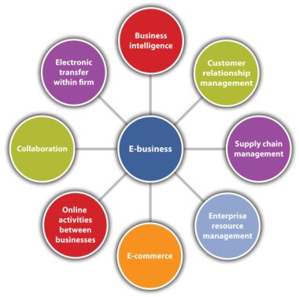
E-COMMERCE vs E-BUSINESS
Notes:
E-commerce is nothing but buying and selling of goods around the web.
E-business is a little different as it is not limited to, commercial transactions, but it also provides other services.
More information: http://www.conceptsimplified.com/compare/difference-between-ebusiness-and-ecommerce/

Slide 5
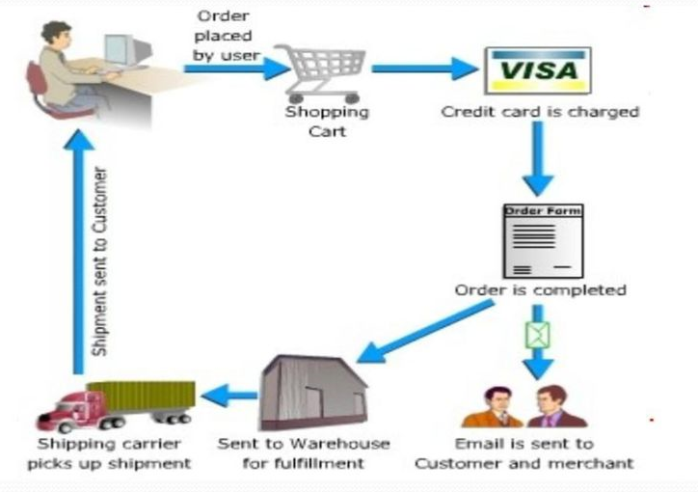
THE PROCESS OF E-COMMERCE
Notes:
1. A consumer uses Web browser to connect to the home page of a merchant's Web site on the Internet.
2. The consumer browses the catalog of products featured on the site and selects items to purchase. The selected items are placed in the electronic equivalent of a shopping cart.
3. When the consumer is ready to complete the purchase of selected items, she provides a bill-to and ship-to address for purchase and delivery.
4. When the credit card number is validated and the order is completed at the Commerce Server site, the merchant's site displays a receipt confirming the customer's purchase.
5. The Commerce Server site then forwards the order to a Processing Network for payment processing and fulfilment.

Slide 6
TYPE OF E-COMMERCE
Business-to-business (B2B)
Business-to-Consumer (B2C)
Business-to-government (B2G)
Consumer-to-consumer (C2C)
Government to consumer (G2C)
Government-to-business (G2B)

Slide 7
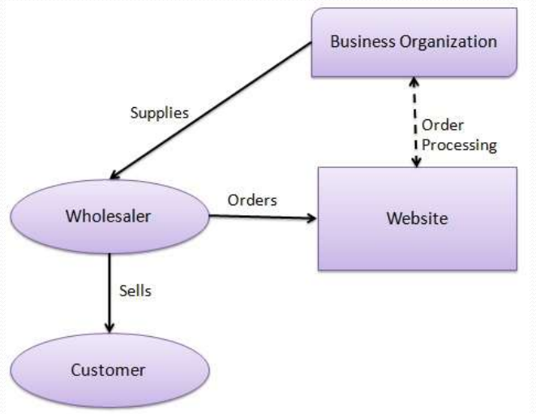
WHAT IS B2B E-COMMERCE?
B2B e-commerce is simply defined as ecommerce between companies. About 80% of e-commerce is of this type.
Examples:
Intel selling microprocessor to Dell
Heinz selling ketchup to Mc Donalds

Slide 8
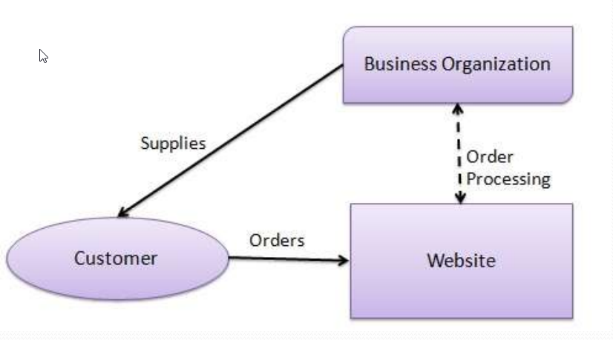
WHAT IS B2C E-COMMERCE?
Business-to-consumer e-commerce, or commerce between companies and consumers, involves customers gathering information; purchasing physical goods or receiving products over an electronic network.
Example: Dell selling me a laptop

Slide 9
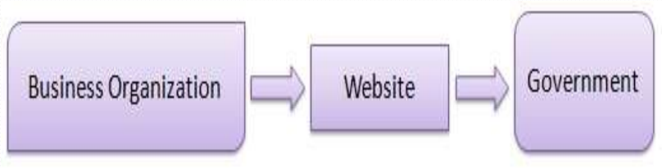
WHAT IS B2G E-COMMERCE?
Business-to-government e-commerce or B2G is generally defined as commerce between companies and the public sector. It refers to the use of the Internet for public procurement, licensing procedures, and other government related operations
Example: Business pay taxes, file reports, or sell goods and services to Govt. agencies.

Slide 10
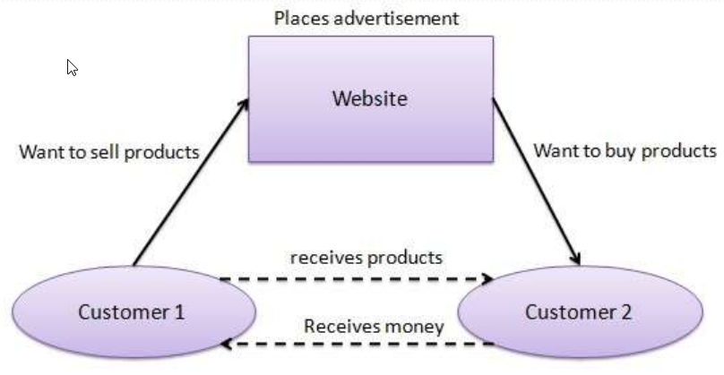
WHAT IS C2C E-COMMERCE?
Consumer-to-consumer e-commerce or C2C is simply commerce between private individuals or consumers.
Example:
Mary buying an iPod from Tom on eBay
Me selling a car to my neighbor

Slide 11
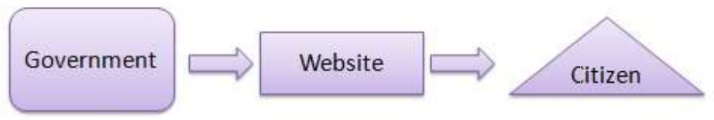
WHAT IS G2C E-COMMERCE?
This Model is also a part of e-governance.
The objective of this model is to provide good and effective services to each citizen.
The Government provides the following facilities to the citizens through website.
Information of all government departments,
Different welfare schemes,
Different application forms to be used by the citizens.

Slide 12
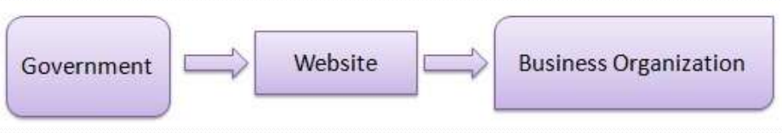
WHAT IS G2B E-COMMERCE?
Government-to-business (G2B) is a business model that refers to government providing services or information to business organization.
Government uses B2G model website to approach business organizations. Such websites support auctions, tenders and application submission functionalities.

Slide 13
ADVANTAGES OF E-COMMERCE
Faster buying/selling procedure, as well as easy to find products.
Buying/selling 24/7.
More reach to customers, there is no theoretical geographic limitations.
Low operational costs and better quality of services.
No need of physical company set-ups.
Easy to start and manage a business.
Customers can easily select products from different providers without moving around physically

Slide 14
DISADVANTAGES OF E-COMMERCE
Unable to examine products personally
Not everyone is connected to the Internet
There is the possibility of credit card number theft
Mechanical failures can cause unpredictable effects on the total processes

Slide 15
TYPE OF SALES CHANNEL
Sell-in:
How many units of a product is a manufacturer selling into the retailer
Sell-in refers to sales from manufacturers to distributors. In this case, a global manufacturer may have one or two national distributors, especially with marketing subsidiaries.
Sell-out:
How many units of a product is selling out to the customer (from the retailer)
Sell-out is sales from these Retailers to end consumers.
E.g. Someone walks into a Bestbuy to purchase a product.

